Slide 1


Slide 2
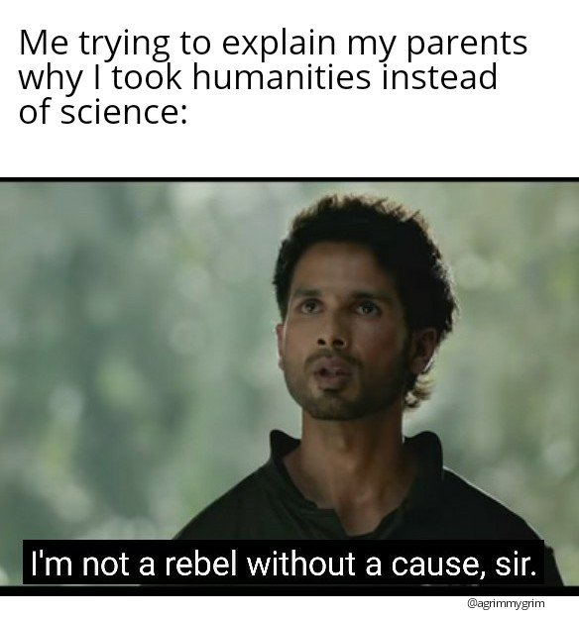

Slide 3
Outline
An understanding of Humanities as a field

Slide 4
Let’s try to understand Humanities
What is humanities? And can we define it?

Slide 5
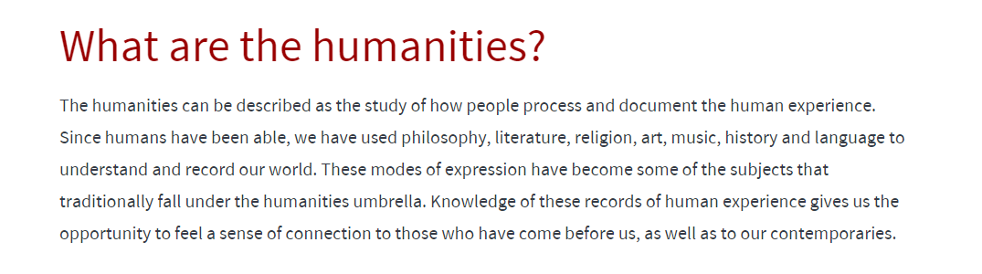
(Mostly western)
Link

Slide 6
What Are the Humanities? Collections by Alan Liu
Do we agree with all these ideologies ?
(what is the difference between critical analysis, critical thinking and critical methods?)

Slide 7
Critical thinking: Able to think clearly and rationally…Additionally, we ask questions, analyze, interpret, evaluate, and form judgments about what we read, hear, say, or write. The word "critical" originates from the Greek term kritikos, which means "able to judge or discern."
Critical analysis: asking questions such as why, how, what etc. to understand certain concept and ideas in the text and try to connect with the knowledge, theories and models you already know.
Critical method: a systematic approach to analyzing, interpreting, and evaluating cultural artifacts, texts, and practices including qualitative study, critical thinking, theoretical frameworks etc.
Analytical approach: Observations, patterns, breaking a topic down into a units, methodologically driven

Slide 8
A quick history
According to Britannica encyclopedia…
“Humanities, those branches of knowledge that concern themselves with human beings and their culture or with analytic and critical methods of inquiry derived from an appreciation of human values and of the unique ability of the human spirit to express itself. As a group of educational disciplines, the humanities are distinguished in content and method from the physical and biological sciences and, somewhat less decisively, from the social sciences. The humanities include the study of all languages and literatures, the arts, history, and philosophy.”

Slide 9
History
Humanities originated from Classical Greek term paideia, a general education course from the mid-5th century BCE.
Paideia prepared young men for active citizenship in the city-state.
Roman scholar Cicero’s humanitas, outlined in De oratore (55 BCE), was a training program for orators.
In the early Middle Ages, Church Fathers adapted paideia and humanitas or liberal arts to Christian education, including mathematics, linguistics, history, philosophy, and science.

Slide 10

The term humanitas fell out of common use in the later Middle Ages but was revived and transformed during the Renaissance.
Fifteenth-century Italian humanists used studia humanitatis to describe secular literary and scholarly activities focused on Classical studies.
Eighteenth-century French critics criticized studia humanitatis for its narrow focus on Latin and Greek texts.
Florence, birthplace of the Italian Renaissance: Source: Wikipedia
By the 18th and 19th century, the humanities distinguished themselves from physical sciences, emphasizing human meaning and purpose.

Slide 11
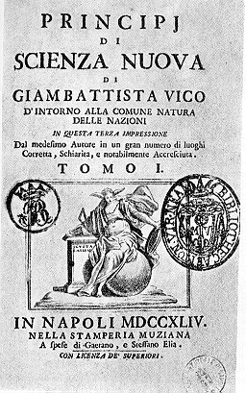
A strong conceptual division between the science of the human and the science of nature dates back to Italian philosopher Giambattista Vico’s Scienza Nuova (New Science) (1725).
"Principles of a New Science Concerning the Nature of Nations, through Which Are Recovered the Principles of Another System of the Natural Law of Peoples".(Wiki)
Wilhelm Dilthey (1833–1911) distinguished the humanities (Geisteswissenschaften) from the sciences (Naturwissenschaften) by methods and objects studied.
Humanities aim to understand the intentions of historical actors.
Humanities investigate “the expressions of the human mind.”
Over the twentieth century, other categories like the social sciences emerged, studying human behavior in social contexts.
Italian (scienze umanistiche), French (humanités), Dutch and Scandinavian languages (humaniora), and Russian (gumanitarnyje nauki).
Source: Wikipedia

Slide 12
German philosopher Wilhelm Dilthey described the humanities as "spiritual sciences" and “human sciences” that lie beyond the physical sciences.
Neo-Kantian Heinrich Rickert argued that the humanities are characterized by their method, focusing on the unique value of the particular within cultural contexts.
American Philosopher Martha Nussbaum emphasized the humanities' importance in fostering democracy, understanding human concerns, and promoting global citizenship.

Slide 13
Outside Europe:
Islamic scholarship formed the basis for studia humanitatis: studia adabiya included grammar, lexicography, poetry, rhetoric, history, and moral philosophy.
In China, the “six arts” of Confucius were rites and rituals, music, archery, charioteering, calligraphy, and mathematics (or prediction).
Guoxue countered the term renwen, a calque of the Japanese term for "humanities" (different from social and natural sciences).
Renwen, still used today, was a retranslation from the Japanese compound originally derived from the Chinese Book of Changes.
Resource

Slide 14
Burdick et al.
The development in the material production and its increased activities: Printing and book productions
Mid-19th century industrial revolution
Increase in the number of public schools and universities
Development of separate disciplines such as literature, philosophy, classics from natural and physical science
New disciplines, archaeology, art history, linguistics
20th Century
English departments: medieval, Renaissance, modern philology
Comparative literature and later postcolonial studies etc.

Slide 15
What about Indian context?

Slide 16
Why humanities is necessary?
“They embody distinctive modes of producing knowledge and distinctive models of knowledge itself” (Burdick et.al 7)

Slide 17
What would be our understanding the concept of ‘Humanities’?

Slide 18
Critical/methods
Culture
Languages
Expression
Time
Memory
Respect
Empathy
Sympathy
etc.

Slide 19
What is it called ‘Humanities’ in your native language?

Slide 20
Humanities in Indian Languages
1.
2.
3.
4.
5.
6.
7.

Slide 21
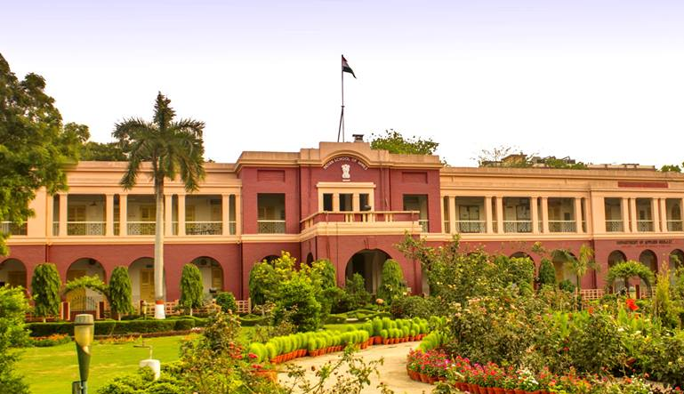
Humanities questions and approaches ?
Cultural heritage building IIT ISM (Dhanbad)

Slide 22
1.
2.
3.
etc.

Slide 23
Any cultural festival in your place?
Any recent bad news about humanity that you come across on newspaper or social media?
Are there any political or scientific event/debates that have left you feeling disgusted?

Slide 24
Debate
Can machines think?

Slide 25
Let’s watch this video!

Slide 26


Objects of study in Humanities

Slide 27


Any Humanities question again?

Slide 28
Maps, paintings, arts, musics, drama, dance and other performance, languages, people, culture etc.
We all digital now!!!

Slide 29
And now we transformed into digital!

